Slide 1

INTRODUCTION
Hello, I'm Prashant Singh
📍 Location: Ahmedabad, Gujarat, India
💼 Role: MERN Stack Developer
🎓 I have completed my graduation from Silver Oak University with a degree in Bachelor of Computer Applications (BCA).
💻 Currently, I am pursuing a MERN Stack Developer course at TOPS Technologies, where I am enhancing my skills in full-stack web development.
🛠️ I have a strong foundation in the MERN stack — MongoDB, Express.js, React.js, and Node.js — and I enjoy building dynamic, user-friendly, and scalable web applications.
🚀 I’m passionate about coding, always eager to learn new technologies, and committed to building real-world solutions that make a difference.
🛠️ Skills:
⚛️ React.js | HTML | CSS | JavaScript | Node.js | Express.js | 🍃 MongoDB | Mongoose | REST APIs | JWT | 🎨 Bootstrap | Tailwind CSS | 🧾 Git & GitHub | Postman | 🖥️ VS Code | NPM

Slide 2


MERN Stack Course Overview
The MERN Stack Course offers an in-depth exploration of the MERN stack, which encompasses MongoDB, Express.js, React.js, and Node.js. This course is tailored for developers who wish to create robust full-stack applications using JavaScript, enabling them to harness the full potential of modern web development.

Slide 3
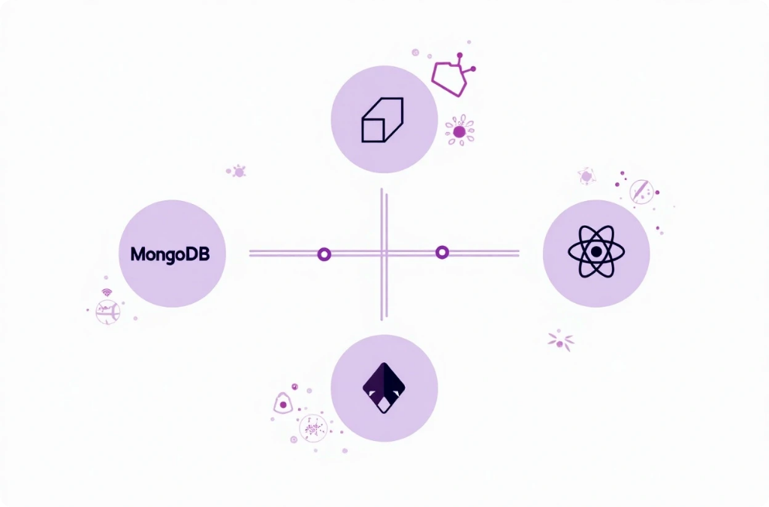


Introduction to MERN Stack
The MERN stack is a powerful web development framework that utilizes JavaScript across both client and server sides, enabling efficient development and code sharing.
What is MERN?
Benefits of MERN
Real-world Applications
A combination of MongoDB, Express.js, React, and Node.js.
Allows developers to work more efficiently using one language.
Ideal for dynamic web applications like social media and e-commerce.

Slide 4



React.js Essentials
Introduction to React
Component Lifecycle
State and Props
React.js is a popular front-end library for building user interfaces, allowing developers to create reusable UI components and manage application state.
Understand the lifecycle of React components, including mounting, updating, and unmounting, to effectively manage component behavior.
Explore how to use state and props to manage data flow within React components, enabling dynamic user interactions and responsive applications.

Slide 5



MongoDB Overview
Data Modeling
Learn effective data modeling techniques, including schema design and the use of collections for efficient data management.
Introduction to MongoDB
2
1
MongoDB is a NoSQL database that stores data in flexible, JSON-like documents, enabling versatile data management.
CRUD Operations
Understand how to perform Create, Read, Update, and Delete operations using queries for data manipulation.
3

Slide 6


Express.js Fundamentals
1
What is Express.js?
2
Routing and Middleware
3
Building APIs
Express.js is a minimal web framework for Node.js that simplifies the development of web applications and APIs by providing essential features.
Learn to build RESTful APIs with Express, including best practices for structuring routes and handling client-server communication.
Discover how to create routes and use middleware functions to handle requests, responses, and errors in an Express application.

Slide 7




Node.js Basics
Asynchronous Programming
What is Node.js?
Learn about non-blocking I/O and event-driven architecture in Node.js, handling multiple connections simultaneously.
Building a Server
Node.js is a JavaScript runtime built on Chrome's V8 engine, allowing developers to execute JavaScript server-side and build scalable network applications.
Discover how to create a simple web server using Node.js, efficiently serving static files and handling requests.
2
1
3

Slide 8



Full-Stack Development
Integrating MERN
Deployment Strategies
Best Practices
Learn how to combine MongoDB, Express.js, React.js, and Node.js to create a full-stack application, connecting front-end and back-end seamlessly.
Explore various deployment options for MERN applications, including cloud services and containerization, to host your applications effectively.
Understand best practices for developing, testing, and maintaining MERN stack applications, ensuring code quality and scalability throughout the development lifecycle.

Slide 9


My Projects
1
NIVIA Sports Clone | JULY 2025
• Built a responsive sports e-commerce frontend using HTML5, CSS3, and Bootstrap
• Designed navigation structure, product listings, and individual product pages
• Ensured mobile responsiveness and a consistent user interface across devices
IoT-Based Object Detection System
2
• Built a real-time object detection system using an ultrasonic sensor and Arduino
• Programmed logic in Python to process ultrasonic sensor input and trigger alerts
Notes:
• Overview of project goals and objectives • Summary of the project's core aims and aspirations. • Identification of the target audience for the project • Focus on understanding the specific group the project is designed for.

Slide 10


How to contact me
1
Name:
parmar prashant
2
Email:
parmarprashantsingh883@gmail.com
3
phone:
9574028096
4
LinkedIn:
linkedin.com/in/prashant-parmar

Slide 11

Thank You & Contact Information
].

